Slide 1
ANALOG SUMMER PROJECT LC-Voltage Controlled Oscillator(LCVCO) with Low Phase Noise -Under Guidance of Prof. Sakshi Arora

Slide 2
Specification Table:
CMOS Technology Node | 45nm
Oscillation Frequency | 7GHz
Voltage Supply Vdd | 1.8V
Control Voltage Vctrl | 0.1V to 1.35V
Tuning Range | 6.7GHz to 7.518 GHz
Phase Noise(P.N.) @10MHz | -131.5 dBc/Hz
Power Consumption | 2.25 mW
FOM | -136.98%
Frequency Gain Kvco | 500MHz/V

Slide 3
Terminology:
VCO: A ideal voltage-controlled oscillator (VCO) is circuit whose output frequency is linear function of its control voltage. i.e. ωout = ωo + Kvco* Vctrl
Phase Noise(P.N.): The short-term frequency fluctuations of an oscillator, typically measured in dBc/Hz at a specified offset from the carrier frequency.
Supply Voltage: The required voltage to Turn ON the VCO is Vdd
Control Voltage: The range of input voltages over which the VCO can be tuned is Vctrl
Output/Oscillation Frequency(fo): fo is the actual frequency output by the VCO, which varies with the control voltage applied to the oscillator.
Center/Carrier Frequency(fc): This is the main or center frequency around which the VCO operates . It is the nominal frequency output by the VCO when the control voltage is at a reference level
Power Consumption(PDC):The amount of power the VCO consumes during operation, usually measured in milliwatts (mW)

Slide 4

Terminology:
Frequency Tuning Range(FTR): The range of frequencies over which a VCO can operate. FTR(%)= (fmax-fmin)*100/fo
Figure of Merit(FOM): FOM provides a standardized way to assess the efficiency of a VCO by normalizing phase noise performance with respect to offset frequency and power consumption
VCO Gain or VCO Sensitivity(Kvco): It indicates how much the output frequency of the VCO changes in response to a change in the control voltage
Kvco =Δfout /ΔVcontrol
Offset Frequency(Δf): Its the frequency difference from the carrier frequency at which specific characteristics of VCO, like phase noise, are measured
Application: Frequency synthesizers, Clock Generation,PLL, Modulation and Demodulation, GPS Receivers, Radar Systems, Bluetooth, WiMax

Slide 5
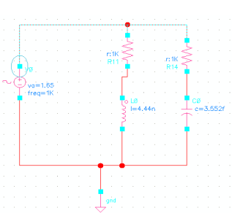

Slide 6
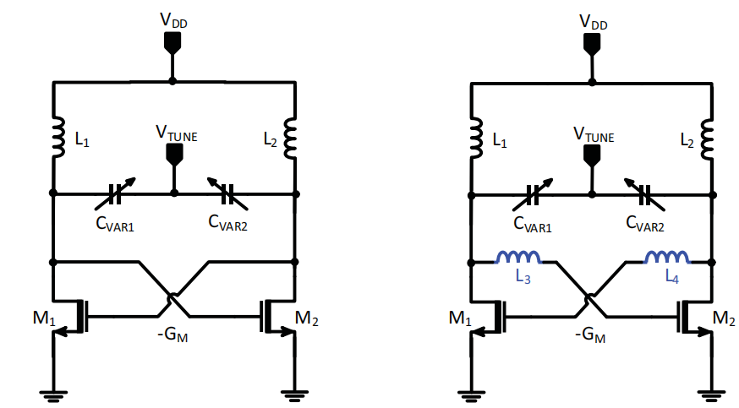
Circuit Diagram: Paper1 & Paper2

Slide 7
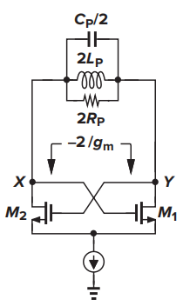
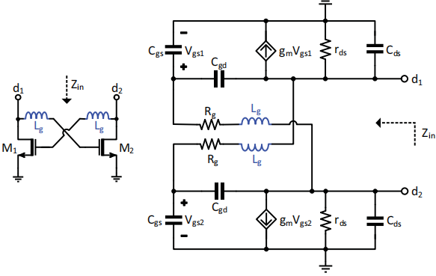
Small Signal

Slide 8
Working Of LC VCO
Initial Noise: A small noise signal starts the oscillation in the LC tank circuit.
Amplification: The noise signal is amplified by the cross-coupled transistors.
Feedback Loop: The amplified signal is fed back into the LC tank, reinforcing the oscillations.
Negative Resistance: The transistors provide negative resistance to counteract losses and sustain oscillations.
Tuning: Varactors adjust the capacitance in the LC tank, changing the oscillation frequency

Slide 9
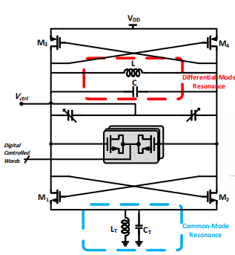
Simulation: Paper3

